Slide 1
Cognition Requires Philosophy
(in progress...)
Towards Unity
Notes:
Presentation look and feel adapted from the “Brain” Microsoft Office Online template.
This is about several kinds of unity
If you are not interested in unity, then this talk may be superfluous
If you are so interested, then I have good and bad news
The bad news is that I paint an extremely depressing picture of today, and the near future
The good news is that “I have a plan”, and it does require philosophy and cognition to work more effectively together
And, of course, I could be completely bonkers like all other scare mongers

Slide 2
Agenda
Time (pm) | Item
1:00 | Start
 | Problem Statement
 | Line of Argument
 | Frustrations → Topic
 | Show
 | Background Info
 | Main Presentation
2:10 | Q & A
2:30 | Discussion @ Mike’s
Notes:
I have too much to cover (originally wanted a 2½ hour talk!
I will skip parts and talk quickly.
Slow me down and ask questions as required, especially if you see something that catches your eye.
Length discussions will be postponed for Mike’s

Slide 3
Problem Statement
Newell (1973 & 1990)
  research programs not adding up
  Oversimplified dichotomies
  unify via integrated control
Today
  Just as bad, even with control

Slide 4
Line of Argument
Cognitive Science unification must proceed in the following order
  Update metaphysics with modern physics
    Remove Substance Metaphysics: what things are
    Introduce Process Metaphysics: what changes
  Qualitatively unify: Philosophy of Cognition
  Quantitatively unify: Cognitive Science

Slide 5
Frustrations → Topic
Frustrated with
  Philosophy
    Includes metaphysics
  Cognitive Science
Topic
  What is the role of Philosophy General with
    Physics
    Metaphysics
    Philosophy of Cognition
      Premature birth
      Rebirth
    Cognitive Science
  What can be improved?

Slide 6
Show
Background Information
How my research fits into things
  Why I need philosophy
  Why this affects you
Why you might require philosophy as well

Slide 7
Background Information

Slide 8
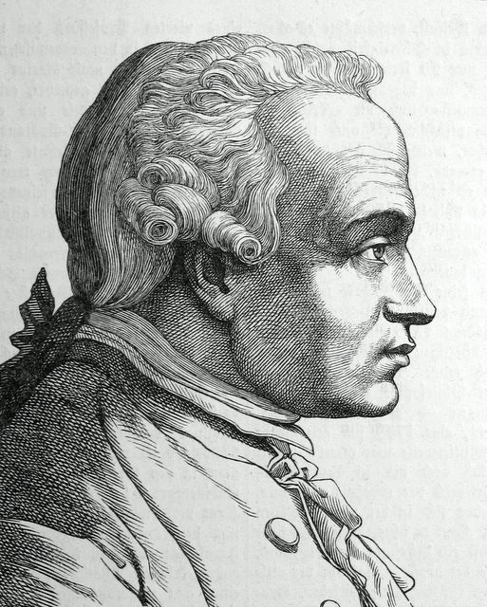
Metaphysics Frustrations
Metaphysics is a dark ocean without shores or lighthouse, strewn with many a philosophic wreck.
– Immanuel Kant
Notes:
Portrait:
From: http://portrait.kaar.at/200Deutsche3/image21.html
Title: (Translated from German) portrait of Immanuel Kant comes from the book "Two hundred German men", published by Ludwig Bechstein, Leipzig the 1854th
Kant didn’t actually say that metaphysics is useless, just that it has yet bear fruit. ???

Slide 9
Metaphysics
How we view and decompose the world
History
  ~500 BC Process Metaphysics lost out to Substance Metaphysics
    Due to bad timing
  ~1900 AD Physics implicitly rewrote metaphysics for themselves with great success
    Huge foundation of Substance Philosophy to overcome
  Philosophy of Cognition and Cognitive Science are still thrashing
    Is it time to put physics explicitly back into metaphysics?

Slide 10
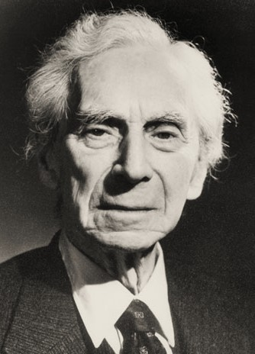
Philosophy Frustrations
  The point of philosophy is to start with something so simple as not to seem worth stating, and to end with something so paradoxical that no one will believe it.
  – Bertrand Russell (1872 - 1970), The Philosophy of Logical Atomism
Notes:
I don’t agree with Russell’s view but am equally frustrated.
As long as each type of analysis is based on crisp black & white substances (conceptions) then paradoxes must result proving black & white wrong.
Process metaphysics will end this state-of-affairs.
Portrait:
From: http://www.qcms.org/Fun%20Facts.htm

Slide 11
Formal Philosophy
Anyone can informally philosophise
  Not aware of dangers
Adds rigour
Awareness of fallacies (errors in reasoning)
Formal and informal tools
  Various logics, e.g. Temporal Logic
  Deduction, Induction, Abduction
  Reductio ad Absurdum, Infinite Regress, Paradox
  Thought Experiments
Greater awareness of related material
Specific Terminology
  Internal Efficiency (Jargon, Lingo)
  External Barrier (Gobbledygook)
    Can anyone truly understand “Intentionality” in less than ½ year?
    Does this matter?

Slide 12
Introduction
Interest: Inducing Formal Qualitative Unified Cognitive Architectures
  By understanding: Time, Change & Recursion
Lead me to the following analogy/summary
This is my circular journey through cognition, philosophy, metaphysics and physics (and back)
  All about motion/change/process – how do minds think
 | Cause | Relation | State Change | Field | Status
 | Momentum | is to | Bodies | Physics | ü ☺
as | Intentionality | is to | Minds | Cognition & Philosophy | û
Notes:
At this point, don’t need to know momentum nor intentionality. Both direct change to a particular direction.
Status of physics is great. We agree on all the terms. They are tangible.
In cognition and philosophy of mind, status is terrible. There is no agreement on most terms. Nothing is tangible.
Can we learn anything from Physics?

Slide 13

Philosophy/Science Framework
Philosophy
Science
Rational
Formal
(Mathematics, Computing)
Empirical
Driven by Theory - Quantitative
Some ground/testability via Thought Experiments - Qualitative
Endless...
Rationality
Cognitive Science →
Reduction
Cognitive Science is not yet scientific (immature)
Reduction Problems
Informs Science
  Conceptual Schema
    Distinctions
    Unifications
  Reduction Schema
    Bad Metaphysics
Biology
Physics
Metaphysics
& Ontology
Notes:
Metaphysics is the foundation for everything
It has been updated by physics, but in a formalism not accessible to others
It has not been updated by philosophy, CogSci nor computational modelling therein
The entire house of cards is about to be toppled
All Science of X are birthed within Philosophy which is diminised and is left with a barnacle Philosophy of X

Slide 14
Metaphysics – Foundation of All
Philosophy
Science
Rational
Formal
(Mathematics, Computing)
Empirical
Cognitive Science →
Biology
Physics
Metaphysics
& Ontology
Notes:
Metaphysics is the foundation for everything
It has been updated by physics, but in a formalism not accessible to others
It has not been updated by philosophy, CogSci nor computational modelling therein
The entire house of cards is about to be toppled
All Science of X are birthed within Philosophy which is diminised and is left with a barnacle Philosophy of X

Slide 15
Metaphysics Is?
As a “first philosophy”, what is metaphysics?
  Classical (general being; ontology)
    Categories of being - things that do not change
    Substance
    First cause (theology?)
  Current (relational among categories)
    Denial of classical thesis (only change, no categories, no 1st cause)
    Modality (of being)
    Space/Time; Personal Identity Across Time
    Mental/Physical; Free Will
    Material Constitution
    Truth? Reference? Analytic
    Ultimate Reality?
  Poorly Defined. Is it even possible?
    Needs to be updated by Physics
Notes:
I will completely redefine all of metaphysics
From: Stanford Encyclopedia of Philosophy; http://plato.stanford.edu/entries/metaphysics/
considers various attempts to show that metaphysics—however defined—is an impossible enterprise.
there are and have been paradigmatic metaphysicians who deny that there are first causes—this denial is certainly a metaphysical thesis in the current sense—, others who insist that everything changes (Heraclitus and any modern philosopher who is both a materialist and a nominalist), and others still (Parmenides and Zeno) who deny that there is a special class of objects that do not change.
‘Being is the most barren and abstract of all categories’ [Hegel, paraphrased];
intermediate topic are supposed to be changeless—but not first causes, since, as Aristotle noted, they are causally inactive

Slide 16
Metaphysics Does
Metaphysics less important for what it is. Most people, including philosophers do not tread into that “dark ocean”.
Metaphysics more important for what it does. Implicitly it affects
  How we view the world
  How we reduce the world
  How we create conceptual schemes for our sciences
Substance vs. Process Philosophy/Metaphysics
  Computer Metaphor – ill understood

Slide 17
Its all about Change
Change causes change causes change causes change...

Slide 18
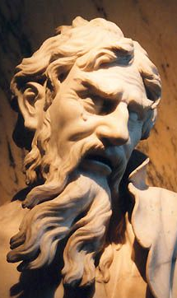
Heraclitus (535-475 BC)
Father of Process Metaphysics/Philosophy
Aphorisms
  “Everything is in a state of flux”
  “The only constant is change”
  “All things are one”
    All things change at the same time and affect each other
  Unity of opposites
    Equilibrium
Notes:
Lead to Plato’s changeless metaphysics
(quoted in Hippolytus, Refutations ) The unapparent connection is more powerful than the apparent one.
http://www.utm.edu/research/iep/h/heraclit.htm

Slide 19
Process Metaphysics Failed – Why?
Change based worldview failed
Heraclitus known as “The Obscure”
Dynamics is more complicated than statics (even today)
Change is full of paradoxes
No ability to measure change (speed)
No formalism
Mystical
  Similarities to Eastern Philosophies/Religions (Taoism, Buddhism)
  Aphorisms reflective rather than prescriptive
    “You can never step into the same river twice”
    Harder to grasp, easily misunderstood
  Internal Orientation
    How to see the world, vs. what is in the world
    Much like enlightenment
    However, still focused about the world vs. internal well being.
    In actuality, an ontological scheme for reducing the world, i.e., a metaphysics
Notes:
As I plan on reintroducing process metaphysics, it is expedient to understand why it failed so as not to repeat history.
Each of these points will be further covered.
Todo
http://en.wikipedia.org/wiki/Original_face (much like philosophy)
http://en.wikipedia.org/wiki/Shunyata **** THEORY OF EMPTINESS ****

Slide 20
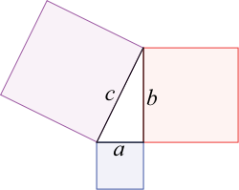
Then Current Mathematics
Pythagoras (580-490BC)
Based on Geometry
Ratios of lengths of string
  Rational Numbers (Fractions)
Theorem: c² = a² + b²

Slide 21
Speed at Heraclitus Time?
650AD: Zero first used in India
820AD: Al-Khwārizmī introduces decimal separator in Iran
1670AD: Seconds measurable via pendulum clock
RateOfChange = 201.345 units/second
~360BC: Eudoxus of Cnidus handles Incommensurable Magnitudes (Irrationals - hints of infinity)
Notes:
~360BC: Treatment of Incommensurable Magnitudes (Irrationals) by Eudoxus of Cnidus
1670: Pendulum clock with second hand
201.345 is not an rational, but we can assume it could be a truncated mathematical outcome of manipulated irrationals

Slide 22

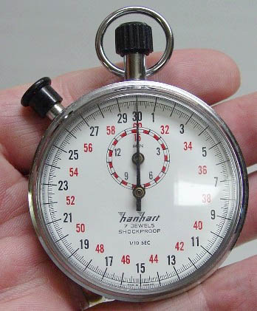
Speed/Time Measurement
1475: Pocket Watch with minute hand
1670: Pendulum clock with second hand
1761: Marine Chronometer (for longitude)
1821: Chronograph (timekeeping + stopwatch)
1888: Speedometer invented (+- 10%)
1910: Chronograph in wristwatch
1967: Quartz Clock (Japan) (1/100th second, stopwatch for sports racing)

Slide 23
Zeno of Elea (490–430 BC)
Motion Paradoxes
  Infinite algorithm by dividing up time
    Achilles and the Tortoise - You cannot overtake something slower
      {1/2, 3/4, 7/8, 15/16, 31/32, ...}
    Dichotomy Paradox - You cannot move
      {..., 1/32, 1/16, 1/8, 1/4, ½, 1}
  Infinite algorithm by dividing up space
    Arrow Paradox – Flying arrow is motionless
      Motion requires a change of position. At any instant (think snapshot) of time, a moving arrow can only move to where it is, or to where it isn’t. It cannot move to where it isn’t, as we are in one instant of time, and it cannot move to where it is, because it is already there and we said the arrow is in motion. Therefore it never moves at any time. [What dichotomous fallacies?]
Change is full of paradoxes, infinities and infinitesimals (time/space) that we do not understand, so lets focus on substance
  Plato (428-347BC) did just that with his Theory of Forms
Notes:
http://en.wikipedia.org/wiki/Zeno_of_Elea
Use audience to show paradoxes.
Heisenberg uncertainty principle states we cannot know both position and speed (momentum) perfectly, i.e., all snapshots must be blurry.
Joke
So a Philosopher, Scientist & Engineer are tasked with overtaking an intelligent woman.
The Philosopher knows ahead of time that he can never reach the girl, so he doesn’t even start.
The Scientist is not so sure. He tries this 30 times until he is a millimetre away. Realizing his mistake, he agrees with the Philosopher and abandons the task.
The Engineer tries this 24 times, finds he is close enough for practical purposes... and asks her for a date.
... She replies: Don’t even start!
Although forms changed, substance philosophy remain entrenched (implicitly) still today

Slide 24
Zeno Interpreted Today
About discrete vs. continuous
Although we have the tools to mathematically handle the net computed result of infinite series, the bottom line is that any algorithm with an infinite number of steps must operationally take an infinite amount of time as Zeno intuited.
  Mathematical or computational equivalence does not equate to operational (nor metaphysical) equivalence over time. [Important to my formalism]
Thus Zeno’s paradoxes are not an indictment against change (which is known to occur), but against treating continuous entities (position in spacetime) as discrete points. There are an infinity of such infinitesimals.
Cognitively/philosophically: one can think but cannot have a distinct thought (nor mental state)
  Moreover, if mind can be reduced to, or supervenes over brain, and if brains are continuous physical systems, so too must the mind
  Am I (yes/no) this instant in a mental state of pain? Or is the level of pain a continuous quantity? Is my level of attention to a cut a continuous quantity?
  My research is in treating almost all things cognitive as continuous, including “rules” and “symbols”. In other words, converting substance to process...
    The only substance remaining is an innate baby mind, all learned things adult forever flow...

Slide 25
Computer Metaphor
Computers are symbol processing systems.
However, when we simulate physics (e.g., weather forecasting) we do not say that the entities being simulated, e.g., clouds, mountains and lakes exchange symbols.
  Symbol processing systems can simulate non-symbol processing systems.
    Non-symbolic systems are almost always stimulus/response systems with quantities that vary continuously
  A real valued (continuous) number should not be metaphysically considered as representing an external substance or state value, even if internal to the computer, it is a symbol
Should the mind be considered as a symbol processing system? I would like to simulate it via continuous means
  Issues with atomic changes to representation
  A computer can be built via only NOR gates – purely stimulus response elements (digital computers are analog systems)

Slide 26
Substance Metaphysics
Current metaphysics is so dominant, it doesn’t have a name. I name it “Substance Metaphysics”
  Language doesn’t help. Everything has a noun form.
Includes temporal logics
  Required as a metaphysical patch – inherently the world does change
  These describe atomic before/after state of affairs, but not how the change transpires
  Includes Functionalism!
Suggest: Greatest philosophical blunder of all time
  We are all paying the price
  Need physics, metaphysics & philosophy to rectify

Slide 27
Physics
Philosophy
Science
Rational
Formal
(Mathematics, Computing)
Empirical
Cognitive Science →
Biology
Physics
Metaphysics
& Ontology
Notes:
Metaphysics is the foundation for everything
It has been updated by physics, but in a formalism not accessible to others
It has not been updated by philosophy, CogSci nor computational modelling therein
The entire house of cards is about to be toppled
All Science of X are birthed within Philosophy which is diminised and is left with a barnacle Philosophy of X

Slide 28
Physics/Math – History of Change
Time | Area | Scientists
322 BC | Ancient dynamic laws | Aristotle
1358 AD | Theory of Impetus | Buridan
1660 | Infinitesimal Calculus* Dynamic Systems, Difference Equations, Differentials | Newton & Leibniz
1687 | Laws of Motion, Momentum Gravity force field has action at a distance. Still problematic | Newton
1822 | Difference Engine* | Babbage
1868 | Control Theory*, centrifugal governor | Maxwell
1874 | Various Infinities, Set Theory | Cantor
1905 | Relativity, E=mc² | Einstein
1926 | Particle-Wave Duality*, Wave Function | Schrödinger +
1927 | Uncertainty Principle (position & momentum) | Heisenberg
1960 | Rigorous Infinitesimals | Robinson
1988 | Time Scale Calculus* | Hilger
Only now do we have a foundation for handling change philosophically The ancients were right to stick to substance, but... *Related to my formalism
Notes:
1½ millennium to overthrow Aristotle dynamics!
Physics/Math has implicitly created an IMPLICIT process based metaphysics.
Metaphysics proper (within Philosophy), still substance based has been diminished of all empiricism
Difference Engine: detect and apply change
Uncertainty/Wave: all snapshots are fuzzy. You cannot crisply split substance and process
Math allows for crisp splitting

Slide 29
Science → Philosophy
Philosophy
Science
Rational
Formal
(Mathematics, Computing)
Empirical
Cognitive Science →
Biology
Physics
Metaphysics
& Ontology
Notes:
Metaphysics is the foundation for everything
It has been updated by physics, but in a formalism not accessible to others
It has not been updated by philosophy, CogSci nor computational modelling therein
The entire house of cards is about to be toppled
All Science of X are birthed within Philosophy which is diminised and is left with a barnacle Philosophy of X

Slide 30
Science X ←→ Philosophy X
In general, there is a steady exchange between
  The Science of X, and
  The Philosophy of X
In many cases, this only concerns the philosophers and scientists knowledgeable in X alone
  Often, they were one and the same individual
    E.g., Einstein with spacetime and quantum interpretations and use of thought experiments
    The ancient polymaths
  Sometimes, opportunity strikes
    E.g., Brooks with subsumption architecture and meaning based on “non-symbolic” embodied reactive behaviours
  In any case, these scientists and philosophers understood each other at some level of discourse
Exchange mostly takes the form of (poor guess at this point)
  Minor simplifications, alternative (dichotomous) viewpoints & conceptions
  Few issues at any one time
  Many philosophical X issues resolvable via grounding of science X
  The exchange is lopsided. Philosophy takes more than it receives
    How does X affect ontology? Meaning? Experience?
    Philosophy slowly becomes self absorbed and looses relevance to a mature science X
However, as philosophy general has been diminished by the birth of the science of X it has increasingly found itself operating in the above mode only
  Philosophy of Cognition (beyond the social sciences) is the most active philosophy left.
  It is currently not-grounded in science (as cognition is not mature)
    Failure of philosophy divorced from science
      no ground, endless rationality, too many dichotomies
    Failure of science divorced from philosophy
      immature science, no paradigm, too many dichotomies, wasted empiricism
  Science and Philosophy need each other!
  Too many unresolvable dichotomies.
  Forgotten how to give birth to a science. When was the last time?
Notes:
http://en.wikipedia.org/wiki/Polymath

Slide 31
Science X → Philosophy Y
I want to introduce the science of change into metaphysics, philosophy and cognition
  Reason is for unity to be made apparent shortly
Why hasn’t this already been done?
  Will show later why temporal calculi are patches
  The jargon of X is not accessible
    Math too difficult
      Wave Functions and Partial Differential Equations, Matrix Operations
      Fields, Tensors, Non-Euclidean Geometry
  Metaphysics & Philosophy has built an enormous house (of cards) based on 2½ millennia of substance metaphysics
    Only I am silly enough to shake such a foundation (but it must be done...)
  The Philosophy of Y is too complicated for Science X
    And in general, philosophy has a bad rap for endless rationality
    Don’t depend on physics to push such ideas into Philosophy of Mind. They will not simplify their physics for our purposes.
      They have withdrawn and created their own implicit metaphysics
      The birth of physics as a science has left meta-physics diminished of all empiricism
    We must make the effort to pull back and simplify these ideas together for ourselves
  The days of polymaths (knowing X and Y) is mostly over
    Life has gotten so much more complicated
Notes:
http://en.wikipedia.org/wiki/Polymath

Slide 32
Process Metaphysics –
Simple Process Example
A simple observed process is formulated as
        A += -A/2 or (1)
The change operator (“+=”)
  updates the observed value on the left-hand side (LHS),
  by the observed influence terms on the right hand side (RHS)
  Update operations take an arbitrarily small amount of time to occur, denoted by ∆t, but this is not normally indicated.
    Much smaller time than an atomic operation. This simulates continuity.
Example could produce the sequence {1, ½, ¼, ... 1/2^{n}} every ∆t
  This could represent a battery becoming discharged
  Note: non-linear exponential behaviour emerges despite being
  simply a linear sum of parts. This is due to recursion.
Process must have self-reference (recursion)
  Allows it to change/unfold over time
  Even if an external stimuli is removed
  This gives it a measure of independence and observed reality
  (This is explicitly not allowed in Causal Bayesian Networks)
Processes are approximate and may ignore minor terms of influence
  This enables processes themselves to change over time
The LHS is also an emergent
  The LHS acts like a state and is said to emerge (that's what all observables truly are)
  Because it is derived from the stateless function: ∆ A(t) = –A/2
  Approximates a substance
    Crisp substances loose their creations, hence substance metaphysics must add intentionality
The RHS is an explanatory (micro) set of changes
  Over iterations, it approximates an atomic discrete operation, but it adds explanatory power
-½
A

Slide 33
Process Metaphysics –
Simple Process Ensemble
All processes in a system interact continuously and are shown in an ensemble. Here is the Lotka–Volterra predator-prey example
  Rabbit += (α*Rabbit) – (β*Rabbit*Fox)
  Fox += (δ*Fox*Rabbit) – (γ*Fox)
The Rabbit*Fox term is not recursive, is not independent, has no observable reality and is simply shown for simplicity
  Represents the chance that fox and rabbits will meet
  Has no delays
RHS influence LHS often
  Interactively
  Terms of Opposition (+ vs. -)
System is time invarient
Rabbit * Fox
1
1
- β
+ δ
Rabbit +=
Fox +=
+α
- γ

Slide 34
Metaphysics Comparison
Item | Process Metaphysics | Substance+Action Metaphysics
Formalism | ∆A = f(A, B) → A += ∆A ∆B = g(A,B) → B += ∆B | A(t) = f(A,B,t); ∆A(t) = A(t) – A(t-1) B(t) = g(A,B,t); ∆B(t) = B(t) – B(t-1)
Mechanism | Algorithmic, Temporal Ordered | Functional, Time Dependant
Sentence | Imperative (+=) | Declarative (=)
Truth | N/A | Yes
Substance | Emerges on LHS as Fuzzy | Crisp
Action | Continuous on RHS as Fuzzy | Crisp/Atomic/Discrete
Power | Explanatory | Descriptive
Substance vs. Action | Joined via += | Disjoint
Causality | Via += | Thrown out with bathwater
Intentionality | Not-needed | Required; Substance causes action; Need interpreter
About | How change affects change, i.e., What happens, What to do | What something is

Slide 35
Philosophy of Philosophy
Suggest that the role of Philosophy General is to
  Give birth to
    a Science of X, and its
    associated Philosophy of X
      Bridging Sciences to/from X and their philosophies
  Diminish itself so ultimately all that is left is
    Philosophy of Philosophy General, and
    Philosophy of Science General
    Philosophy of various Social Sciences
      These are normative and we mere mortals are not Gods
      Nor is evolution directed nor final – its an anarchist free for all
      Too many conflicting “Free Wills”

Slide 36
Birth of a Science
Philosophy
Science
Rational
Formal
(Mathematics, Computing)
Empirical
Cognitive Science →
Biology
Physics
Metaphysics
& Ontology
Notes:
Metaphysics is the foundation for everything
It has been updated by physics, but in a formalism not accessible to others
It has not been updated by philosophy, CogSci nor computational modelling therein
The entire house of cards is about to be toppled
All Science of X are birthed within Philosophy which is diminised and is left with a barnacle Philosophy of X

Slide 37
Birthing a Science - Historical
Cognitive Science seems to be the last science to be birthed
Philosophy has forgotten how to do so
  It is in the Philosophy of X mode forming distinctions galore
  Historically, the few ancient polymaths wore both science and philosophy hats
    In any case, they worked extremely closely
      Shared the same jargon
  Today, philosophy has gotten too big – too many non-polymaths
    Its own unique jargon that has become too confused and less relevant to foetal sciences
Kuhn suggested a paradigm shift needs to occur
  Only a philosophical unification can do so

Slide 38
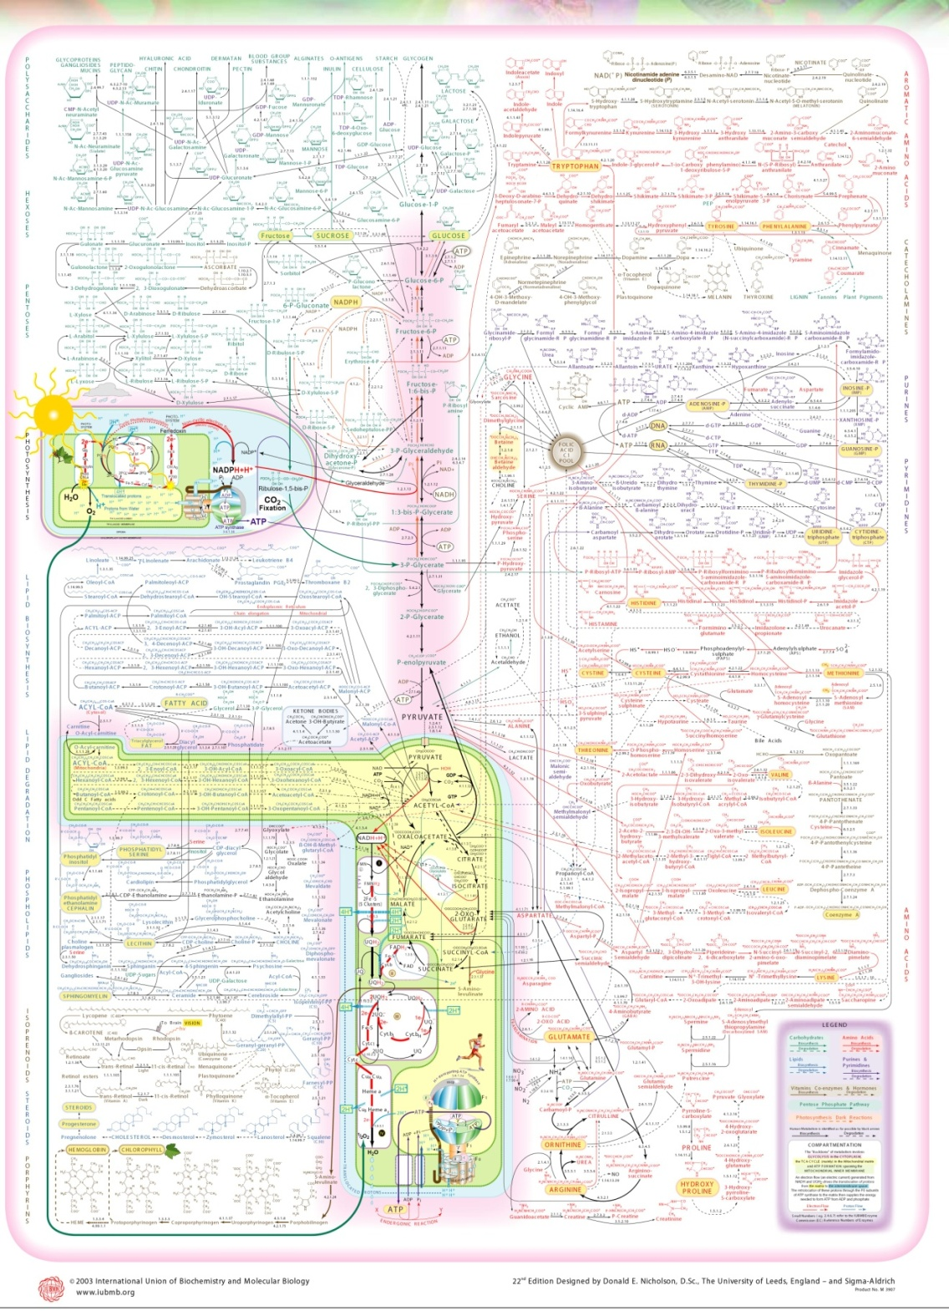
Is Cognition Too Complex?
Metabolic Pathways
With numerous interacting processes
Notes:
Complex TANGIBLE systems can be (anti)reduced. Emergence is not an issue.
Nicholson, D. (2003) IUBMB-Sigma-Nicholson Metabolic Pathways Chart. 22nd edition. Sigma-Aldrich.

Slide 39
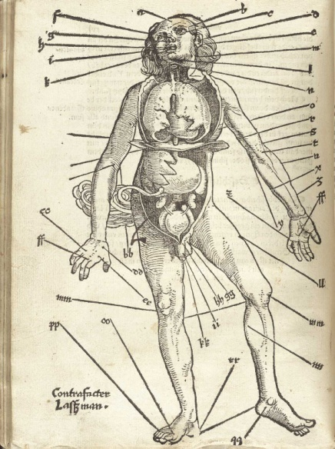
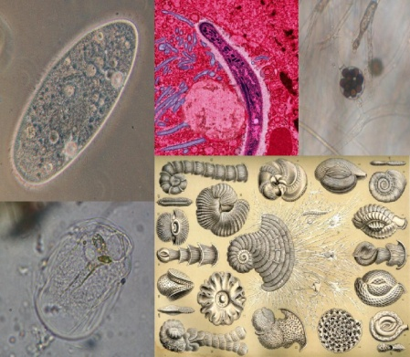
(Anti)Reducing Complexity
Complex systems can be (anti)reduced
  As long they deal with (unified/agreed upon) tangibles
    Water, Air, Earth, Fire (but not Aether)
    Galaxy, Corporation, Country, Family, Herd
  A few hypothesized non-tangibles are eliminated when science allows for direct observation
    370BC (Hippocrates) Humours (Blood, Yellow/Black Bile, Phlegm), bloodletting
    1632AD (Leeuwenhoek) Microbiology
    1858 (Virchow) Cell Pathology
  Processes harder
    Phlogiston → Oxidization
Notes:
http://upload.wikimedia.org/wikipedia/commons/3/31/Gersdorff_Feldbuch_s16.jpg
http://upload.wikimedia.org/wikipedia/commons/2/24/Protist_collage.jpg

Slide 40


Intangibles
Chasing endless surface features or symptoms
v.s. simpler deep structures or processes
  f_{c}(z) = z² + c (recursed)
  Colour depends on speed of divergence
Not implying cognition is this bad!
Notes:
http://upload.wikimedia.org/wikipedia/commons/a/a4/Mandel_zoom_11_satellite_double_spiral.jpg
http://en.wikipedia.org/wiki/File:Mandelbrot_color_zoom.gif

Slide 41
Intangible Reduction
Requires unification
  E.g., Geocentrism vs. Heliocentrism
Judicious use of Occam's Razor
  Would not have applied to the above initially
  Number of distinctions in Philosophy of Cognition far exceed the practical number of things considered in Cognitive Science

Slide 42
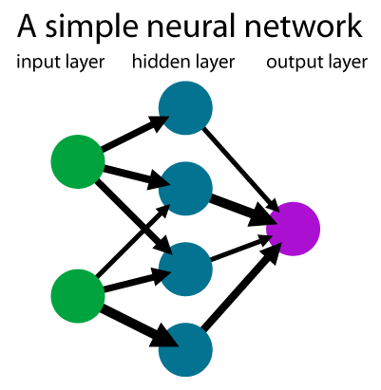
Many Intangibles
Reduction in science progresses easily when
  Only a few significant dichotomies at a time
  At the edges of the unknown
  Like a single layered neural network
    Hypotheses compete, and empiricism slowly changes their relative merits
Cognition is a case of too many significant intangibles at all layers
  Hypothesis are dynamic and change with empiricism
  Sometimes against accepted evidence, or poorly understood philosophical truths (vehicles vs. content)
  Anarchy (Feyerabend)
    So much so that everyone shrugs their shoulders, ignores philosophical warnings and competitive hypothesis, and continues on their own path

Slide 43
Mind Reduction?
The mind cannot be reduced via substance thinking
  Because it is not tangible
  No agreement on what it is
  No agreement on any of its parts
  Each philosopher and scientist has a different, if not private, theoretical set of parts
    Although one part could connect to another, the theoretical sets cannot
    Its an apples and oranges debate
    With so many dichotomous choices in parts and assumptions, the chance of any set being correct approaches nil
Mind slightly more easily reduced via process thinking
  Each part is fuzzy and can gradually morph to another so that theoretical sets can connect
    An apple can become an orange
    However, such gluing can become an unmanageable mess of epicycles

Slide 44
Computer Reduction Issues
Already seen that computers can simulate both symbolic and continuous systems
What about Marr’s tri-level hypotheses?
  Any hardware layer can be simulated by software
  Simple software functions can be replaced by dedicated hardware accelerators (e.g., sorting)
  Each layer can be tri-layered within
    Is the algorithmic layer within all layers still the algorithmic layer for the system?
  Many software modules are not layered but are networked
Miller’s 7±2: is that a
  (neural) implementation,
  (strategic) algorithmic or
  computational (problem) limitation? Which is responsible for response time?
Systems are multiply realizable on all accounts
Looked closely, the brain is known to be a non-layered complex networked mess unlike hardware engineered products

Slide 45
Unification – Not
Not connecting existing theories together
  They do not ordinarily fit!
    Meaning based on symbols or behaviour
    ACT-R control models
  When they do, there is less of a problem
    Categorization is a mixture of Templates & Prototypes
    Attention can have both early and late selection
    Brain often has multiple connective paths between two systems
      What and Where visual processing streams
    Of course dynamics between the two or more...

Slide 46
Unification Requirements
Unification requires
  Major synthesis (breadth with significant depth)
  Brand new coherent hypothesis →Paradigm Shift
  Re-carving nature at her joints – Plato
    Must have few renaissance butchers
      Most others can continue along (but keep an eye out for connections)
      Create fuzzy conceptions (more later)
    New conceptual categories
    New Ontology
    New metaphysics
      Obliterate most existing dichotomies
      Easier to agree on what things do vs. what things are (meaning, consciousness)
  Like software engineering
    As more functionality accretes, or more systems integrate, software becomes convoluted and must be refactored (reorganized)
    Despite our best system analysis techniques (CMMI), even in military, both complex design and implementation end up being refactored, especially due to unforeseeable dynamics.
      E.g., Strategic Defence Initiative, Air Traffic Control
  Inducing the mind qualitatively (in Philosophy) before being reduced quantitatively (in Science)
Notes:
SDI too complicated
http://books.google.ca/books?id=2lo3OYwwJ1YC&pg=PA187&lpg=PA187&dq=%22strategic+defense+initiative%22+%22too+complicated%22&source=bl&ots=OL2Cfb-ipx&sig=KbBAF6RYf5GQOKs3Cnu1hYsBFig&hl=en&ei=iZ6lSfCABoTFnQec4sSmBQ&sa=X&oi=book_result&resnum=2&ct=result#PPA186,M1

Slide 47
Unification via Induction
Implemented a Process Network Architecture
  For Philosophers and Cognitive Scientists
  Try out various combinations of parts to
    See if they have the causal power to do what they need to do for the entire system to have qualitative intelligence
    Even polymaths cannot keep track of such complex interactions
  Have a specific Cognitive Architecture in mind
    In progress
    Future presentation

Slide 48
Unification - Why
Do our parts have the necessary machinery to do what they need to do?
  In our layering and approximations, have we thrown the baby out with the water
  Have we shuffled the hard problem elsewhere?
    Infinite regress? Homunculus?
Philosophers say this several ways
  Do the parts have the necessary causal powers?
  Are we manipulating vehicles rather than content?
  Does the high-level reduce to (or supervenes over) the low-level (or emerge from it)? If not, where does the extra content come from?
E.g., Symbols, in themselves, have no causal powers
  They require an interpreter. Is that a homunculus?
  The only causal power in a computer machine stems from the movement of electrons – a process – a change, i.e., energy. There is no “computer” per se, no software, nor symbols! All is continuous at this level.

Slide 49
Metaphysical Unification
Process metaphysics unifies substance and atomic change
  Substances are fuzzy, less than they seem and can become, bego, bemorph and beinteract
  Macro changes are made causally continuous by looking at micro changes. They are more than they seem. They can interact.
  Focus is on recursive architectures and emergence
Many philosophical distinctions based on crisp dichotomies are shown to be false dilemmas
  Process philosophy is the excluded middle
  Intentionality disappears as it was the causal baby of process philosophy that was thrown out with the water when crisp substance based approximations were made
A simpler unified philosophy of mind enables unity in cognitive science

Slide 50

Process Network Example
Automatically generates missing info
  blink
  Optical blind spot
Continuous Interaction
  Bottom-up
  Top-down
Incremental Learning of Dynamics
  Not solution
  No substance (weights)
  Adaptive
Incremental Levels
  Improve accuracy
No Delay
  8 Spreadsheet Columns
Delay
  Need Network
  +Efferents
Far Predictors
  Not needed
dPrv
dNow
dErr
dF_{3,2}=2
dF_{3,1}=5
dF_{3,0}=14
pF_{3,1}=42
pF_{3,2}=90
pF_{3,3}=165
Level 3
t-7
t-6
t-5
vPrv
vNow
vNxt
dPrv
dNow
dErr
dF_{2,1}=2
dF_{2,0}=5
pF_{2,1}=14
pF_{2,2}=28
pF_{2,3}=48
Level 2
t-5
t-4
t-3
vPrv
vNow
vNxt
Level 1
dPrv
dNow
dErr
dF_{1,0}=2
pF_{1,1}=5
pF_{1,2}=9
pF_{1,3}=14
Detectons/Changeons
t-3
t-2
t-1
vPrv
vNow
vNxt
dPrv
dNow
dErr
pF_{0,1}=2
pF_{0,2}=3
pF_{0,3}=4
Level 0
t-1
t
t+1
vPrv
vNow
vNxt
f(t) = at³ + bt² +ct + d
Value In(t)
dNow
dNow
dNow
Predictons
t+2
t+3
t+4
vNxt
vNxt
vNxt
Level 1
Level 2
Level 3
Prediction Out(t+1)

Slide 51
Philosophy → Science
Philosophy
Science
Rational
Formal
(Mathematics, Computing)
Empirical
Cognitive Science →
Biology
Physics
Metaphysics
& Ontology
Notes:
Metaphysics is the foundation for everything
It has been updated by physics, but in a formalism not accessible to others
It has not been updated by philosophy, CogSci nor computational modelling therein
The entire house of cards is about to be toppled
All Science of X are birthed within Philosophy which is diminised and is left with a barnacle Philosophy of X

Slide 52
What can Philosophy do for You?
Short Term
Cognitive Science is in Anarchy
  An example of runaway empiricism without a paradigm
    What happens when a baby is born premature with no one to guide
    In panic mode thrashing everywhere
  Newell himself suggested that the normal means of science may not suffice and that unification, although required, is a fantasy
  There are too many detailed and quantitative theories of incompatible and inconsequential surface features to make unification possible or desirable
  Process metaphysics/philosophy can minimize this increase in entropy/anarchy/disorder now
Normally, a mother would scold such a child, but philosophy does not speak the same tongue and the child will not listen
  Short term: Philosophy must make itself immediately relevant to and listened by cognitive science
    Simplify, do not complexify (we are in birthing mode)
  Process philosophy will help obliterate numerous dichotomies
  Pay attention to your mother

Slide 53
What can Philosophy do for You?
Long Term
Philosophy of Cognition can more readily unify
  Simpler, because it is at a qualitative level
  Does require process philosophy
  Does require computation tools for philosophy
  Produces a qualitative unified cognitive architecture – the paradigm shift
At this point, Cognitive Science can be reborn and start reducing the intangible
  All hypotheses need to be recast (or start over again)
  This will be iterative
    A much reduced philosophy of cognition will speak the same tongue as Cognitive Science
    Will work for/with cognitive science, rather than being internally focused
A qualitative computational Cognitive Architecture can be quantitatively extended

Slide 54
Status of Cognitive Science
Make no mistake. Today, Cognitive Science is nothing more than speculative philosophy
  It is has not been born in practice
  It is interdisciplinary in terms of
    Knowing who the players are
    Superficially understanding their language
    Still in the forming stage of group dynamics
  But not in having a common language – the paradigm shift
    Need to storm, norm and finally perform
  Work closely with philosophy
  Yes, all Cognitive Science products will feed into qualitative models so no need to suddenly terminate your work
    Do try to direct your work to higher, qualitative concerns, rather than deep technical divides.
      Start philosophizing – you might come to like it ☺
    It will help to have a unification eye now

Slide 55
Conclusion -
From a Cognitive Science Perspective
We are a special science because
  We are premature and must be reborn
  We come late in the game, and mother has forgotten how to give birth
    She is now too used to scolding our sisters and arguing with dad
  We try to reduce the intangible – it has never been done before
    Must ask mom for help
Philosophy is important because we all practice it
  Let’s learn to do it well
Philosophy must simplify so we can understand mom
  We need our own baby-talk
Philosophy must qualitatively unify to birth us in practice
As adults, we must jointly iterate the qualitative to the quantitative
  With mutual respect and understanding
We must not forget our elder sister Physics
  All roads lead through the process metaphysics she has pioneered
  We’ll just use some simpler tricks
Computers make the worst metaphors, but are formally indispensible

Slide 56

PS.
Sometimes mother likes to talk in paradox. Often, dad argues in kind. That's when I need to look at the world differently and seek enlightenment. They never tell me how!
Likely, the same thing is true when mom and dad argue over the same thing for (100s of) years.
I think they are both Buddhists.

Slide 57
Q & A
Time (pm) | Item
Part I
1:00 | Audience Survey
1:10 | Main Talk
2:10 | Q & A
Part II
2:30 | Discussion @ Mike’s
? | Sleep...

Slide 58
Reference or Deleted Material

Slide 59
Pedagogy – State of Affairs
Cognitive Science is a premature baby
  Textbooks contain lists of varied approaches and theories
    Nothing is mentioned of accepted theories
    Professors that contradict each other
  Inclusion of Philosophy
    What other sciences do so for the general students?
    Not even written for Cognitive Scientists!
It strives to appear as a (scientific) adult
  Certainly it does use empirical methods
    But are these chasing analytical creations?
  Simplifies the problem
    Layered reduction vs. complex networks
    Analysis of individual and approximated parts rather than systems
    If only we had more compute power!
  Superficial breadth

Slide 60
Pedagogy - Suggestions
Two Streams [Tentative]
  Current Specialized Stream (for majority)
  Unification Stream (for the few)
    Detailed breadth and depth
    Needs a change in how degrees granted
      Synthesis and breadth not rewarded
      Possibly a much longer program (with funding issues)
    All co-supervised with one specific faculty “unifier”
      Working together on one continual unification project
    Collocated
  Work with Philosophy of Cognition to create a unified (process based?) ontology
    More analogies to computers as the embody the spirit of cognition
Focus on current critical issues and outstanding problems
  Less history
  Possibly taught by dissenting professors simultaneously (or one in science and another in philosophy)
    Good to know what people do in fact agree upon
  Actually help us to determine thesis topic
Focus on bridging work
  Vs. loose connections
  Teach how to bridge – an eye on systems thinking
Philosophy (& Linguistics) taught specifically for Cognitive Science
  Make it relevant to non-philosophers and non-linguists
  Students can contribute to edited (online?) textbooks
Mandatory presentations and attendance every year
Teach process philosophy
In progress... To get discussions going

Slide 61
Keywords (Areas Covered)
Philosophy
  Philosophy of Science
    Decomposition/analysis, reductionism, unification/synthesis
  Metaphysics, Ontology
    Substance, process, change, action, behaviour, event
    Stimulus-response
    Formalism
    Causality, Relations/Reference, Emergence, Truth
  Philosophy of Mind
    Philosophy of Language
  Theory of Knowledge (Epistemology)
Cognitive Science

Slide 62
About Me
I am not a formal philosopher, and likely never be
  Most of the views/errors expressed will be my own
  Please do correct/interrogate me throughout!
In my previous life I was a Computer Engineer
  Worked on telecommunication management (human machine interaction) software - very complicated systems
  As senior developer, designer, architect
  As team and project leader, manager
  Like to use small circuits & software as grounded thought experiments
In my new life, hoping to become a Cognitive Scientist
  Cognitively/developmentally inspired AI
  Process Metaphysics
What I was fundamentally shapes what (& how) I want to become
Now I’m tired. Please excuse the slightly depressing attitude
Notes:
Not being a formal philosopher is an asset as we will see.
What am I?
Never the same
Not an identifiable substance with specific states
A continuous process

Slide 63
Confession
I have a ☺/☹ relationship with philosophy...
☹Find it extremely frustrating
  Why?
☺“Feel” it to be important and not ignorable
  How?

Slide 64
Presentation Purpose
Complaining is not enough...
Explore the reasons for deep seated feelings from a semi-outsider perspective
Suggest improvements in philosophical
  Pedagogy (taught)
  Content (theory)
  Application (traditions within and without)
Energize others about Philosophy
Notes:
Are suggested improvements
selfish to my point of view, or for the
good of philosophy/cognition in general?
You must be the judge.

Slide 65
Result Summary
Philosophy is the most significant aspect within cognitive science today
  But it must also change with the times
A change based metaphysics is introduced to solve world hunger
  Crisp substances are the root cause of all evil
  But not consciousness and qualia yet
How it will help/affect you?

Slide 66

Doctor of Philosophy
We all have a Ph.D., (or aspire to one)
  So we better darn well know how to philosophize!
Philosophy is the mother of all science
  We will investigate the relation between Philosophy and Science
    Relation between Science of X and Philosophy of X
    Relation between Philosophy and aspiring Science of X, e.g., Cognitive Science
    Diminishing of Philosophy and change in tradition
We all philosophize, or listen to those that do
We all engage in philosophy every day
  Investigate explicit (not much) and implicit usage
  We will investigate how philosophy affects us implicitly every day
    Implicit impacts (view the world, reduce the world, hypothesize, judge/prioritize/rationalize similar/opposing viewpoints (differences that matter)
    Computer Metaphor

Slide 67
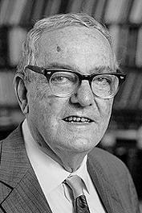
Problem - Simon
Herbert Simon (1916-2001)
[had some quote ??? About hoping to unite symbolic and behaviour approaches ???]
Notes:
http://en.wikipedia.org/wiki/Herbert_Simon

Slide 68
Summary
Philosophy & Metaphysics
  Prior to Physics as a Science
    Rejected Change & Focused on Substance (~500BC)
Physics as a Science
  Came to understand Change/Motion/Process well
  Not accessible to other fields (Cognition & Philosophy)
Philosophy & Cognition
  Still based on ancient metaphysics
    Will discuss negative impacts to both
(Neo) Process Metaphysics
  Accessible Formalisms (& tools)
  Will discuss positive impacts to Philosophy & Cognition
  How it can help you!

Slide 69
TODO [Summary]
Analytics vs. reality
Crisp vs. Fuzzy
Critique of Philosophy
  Used to drive all sciences; Now reacting, and inward talking
  Used to unify; now only differentiate
  Used to be grounded; now only rational and non-empirical

Slide 70
Philosophy → Science
How does philosophy contribute to Science?
The mother of all sciences
  Historical (Birth of a Science of X)
    Conceptual schema
    Conceptual change/paradigm shifts (Kuhn)
      Unification
    Reduction schema (via metaphysics – not appreciated)
  Current (Philosophy of X)
    Clarification (specifying, simplifying)
    Distinctions that matter (complexifying, new avenues of research)
    Relating elsewhere (starting Bridging Sciences)
Rationality
  Logic and other formalisms, Noticing Fallacies
  Scientific method (empiricism, falsifiability)

Slide 71
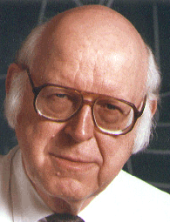
Problem – Newell (1973)
Allen Newell (1927-1992)
  1956: Dartmouth Conference: Birth of AI
1973: You can’t play 20 questions with nature and win
  Matters become muddier with time
    [wrong conceptions; chasing surface features]
  Never-ending series of clarifying experiments
    [Just like philosophy! → Not yet a (mature) science!]
  Oversimplified Dichotomies
  Research model will not “add up”
    [The hard part is always shifted elsewhere]
  Suggests
    Model (invariant) control structures
      [just as non-integrated today. A baby’s mind?]
    Integrated Systems (for unity)
      Normal means of science might not suffice!
        [Understand reductionism]
        [need new metaphysics]
        [need breadth]
Notes:
http://en.wikipedia.org/wiki/Unified_theory_of_cognition
Some linguists and developmental robotacists do only start with an innate baby.

Slide 72
Problem – Newell (1990)
1990: Unified Theories of Cognition
  Holism/Integration/Unity is a “fantasy” in practice
  Prioritized list of investigation
    Focus on integrative control
    [Who does so?]
Today:
  Just as bad
  Hundreds of disparate control models (ACT-R, etc) not integrated nor adding up
  Need a systems approach [but why?]

Slide 73
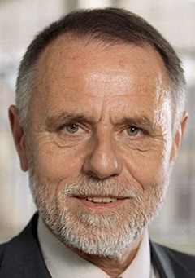
Problem - Bibel
Wolfgang Bibel (1938)
  German AI Founder
2000: in “AI's greatest trends and controversies” (Hearst & Hirsh)
  Too many specialized logics
    [Metaphysical separation of substance and action]
  Integrated into a “single powerful, and yet uniform system”
    [Process Metaphysics]
Notes:
http://en.wikipedia.org/wiki/Wolfgang_Bibel
Marti A. Hearst & Haym Hirsh (2000) AI's greatest trends and controversies. IEEE Intelligent Systems and their Applications, 15(1): 8-17. (@IEEE)

